Slide 1
Microbiology user manual
Version 6: January 2023

Slide 2
Microbiology Samples Health and Safety Considerations To reduce the risk of Laboratory acquired infection by exposure to potentially hazardous clinical samples please include all relevant clinical info pertinent to the sample being sent; such as but not limited to:
RISK FACTOR | INFORMATION WHICH MAY ACT AS A CONTROL MEASURE
TRAVEL HISTORY | FOREIGN TRAVEL WITH REGIONS SPECIFIED
ORGANISMS SUSPECTED | Brucella sp. Burkholderia pseudomallei, Bacillus anthracis, Salmonella typhi, Vibrio cholerae, Tapeworms, Neisseria meningitidis, Q-fever, E.coli 0157, RickettsIa, Shigella dysenteriae, Coccidioides, Histoplasma, Penicillium marneffei,
EXPOSURE TO KNOWN HAZARDS | TB CONTACT, NEEDLESTICK INJURY, BITES, ANIMAL WORKER, DUST/HAY, EBOLA CONTACTS
PAST CLINICAL HISTORY | PREVIOUS TB, IMMUNOCOMPROMISED, TICK BITES, CONTACT WITH BIRDS/BATS, PRION EXPOSURE, EBOLA CONTACTS
OTHER RELEVANT INFORMATION | UNPASTEURISED MILK, PASSING PARASITES IN STOOL, WOUND LESION OR BLISTER DESCRIPTION, LOCATION OF PAIN, DIFFERENTIAL DIAGNOSIS, Erythema nodosum, BLOOD DIARRHOEA, VIRAL HAEMORRHAGIC FEVER

Slide 3
Test/Sample Type | Turn round time for results
THIS SECTION WILL HIGHLIGHT EITHER SAMPLE TYPE AND/OR TEST | THIS SECTION WILL INCLUDE DETAILS OF TURN AROUND TIME OF SAMPLE FROM RECIEPT TO RESULT (DAYS/%TARGET)
Sampling Advice: HYPERLINK TO SAMPLING GUIDANCE
Sample Container:
REQUIRED SAMPLE CONTAINER
Specimen Requirements/ Potential interferants in the assay (drugs/ dietary compounds)
PICTURE OF RECOMMENDED
SAMPLE CONTAINER
WHERE THE UKAS SYMBOL IS FOUND THE
TEST HAS BEEN APPROVED BY UKAS AND
CAN BE FOUND ON THE UKAS WEBSITE BY
FOLLOWING HYPERLINK
Health and Safety Considerations
Please ensure relevant clinical
Information is provided to highlight
risks associated with this sample type
Such as:
REFER TO CLINICAL INFORMATION
Royal College Demand Management.
Where applicable samples should not
be repeated within the stated timeframe
unless clinically indicated.
8707
BOLTON MICROBIOLOGY UKAS SCHEDULE WEBSITE

Slide 4
SIGNIFICIANT ADDITIONAL LABORATORY TESTING
PLEASE FOLLOW THE HYPERLINK FOR A FULL LIST OF BOLTON ROYAL NHS FOUNDTION TRUST UKAS APPROVED TESTING SCHEDULE 8707
BOLTON MICROBIOLOGY UKAS SCHEDULE WEBSITE
TESTING | USER INFORMATION | UKAS STATUS
AUTOMATED SENSITIVITY TESTING | ALL SIGNIFICIANT BACTERIAL GROWTH | ACCREDITED
DIRECT ANTIBIOTIC SENSITIVITY TESTING | BLOOD CULTURES AND OTHER SAMPLES | NOT ACCREDITED
EUCAST ANTIBITOTIC SENSITIVITY TESTING | ALL SIGNIFICANT BACTERIAL GROWTH | ACCREDITED
PARASITE DETECTION | ALL SUITABLE FAECES SAMPLES | ACCREDITED
MRSA PCR | ON REQUEST OR INTERNAL RESULT VERIFICATION | ACCREDITED
TB PCR | ON REQUEST OR INTERNAL RESULT VERIFICATION | ACCREDITED

Slide 5
HYPERLINKS TO SPECIFIC TESTS
AAFB/MYCOBACTERIAL CULTURE
BLOOD CULTURES
BIOFIRE MENINGITIS PCR
CARBAPENEMASE DETECTION
CHLAMYDIA/GC DETECTION
ENVIRONMENTAL WATER SAMPLING
FAECES CULTURE
COVID, FLU A/B, RSV DETECTION
FLUIDS (CHEST, BAL, NBL)
C.DIFFICILE TESTING
GENITAL CULTURE
GUM SAMPLES
HELICOBACTER PYLORI DETECTION
HERPES VIRUS DETECTION
MRSA SCREENING
MYCOLOGY SAMPLES
NOROVIRUS DETECTION
ROTA/ADENOVIRUS DETECTION
SPUTUM CULTURE
STERILE FLUIDS (CSF/JOINTS)
URINE CULTURE AND SENSITIVITY
URINARY ANTIGEN TESTING
(LEGIONELLA, SPNEU)
WOUND SWABS
TISSUE SAMPLES
VRE SCREEN
If you are unable to find the required Microbiology test within this handbook, please check the Assay Finder before contacting the Laboratory

Slide 6
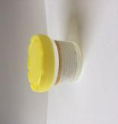
Test/Sample Type | Turn round time for results
AAFB/Mycobacterial Culture • Microscopy • Culture | 24/7 Service for urgent requests; 2 working day for routine. (90% KPI) 7 weeks (90% KPI)
Sampling Advice: ROYAL MARSDEN SPUTUM SAMPLING
Sample Container:
YELLOW LID 60ML STERILE CONTAINER
Specimen Requirements/ Potential interferants in the assay (drugs/ dietary compounds)
Fresh Sample
Samples may be cultured up to 48hrs after collection although interpretation of results should be done with care.
Leak Proof Container in sealable bag.
Health and Safety Considerations
Please ensure relevant clinical
Information is provided to highlight
risks associated with this sample type
Such as:
TB Contact, Previous TB
Royal College Demand Management.
Where applicable samples should not
be repeated within the stated timeframe
unless clinically indicated.
Not applicable
8707
BOLTON MICROBIOLOGY UKAS SCHEDULE WEBSITE

Slide 7
Test/Sample Type | Turn round time for results
• Blood Culture Investigations | Negative results 5 days (95% KPI) Positive Results 5-7 days (95% KPI)
Sampling Advice: ROYAL MARSDEN BLOOD CULTURE CV ACCESS ROYAL MARSDEN BLOOD CULTURE PERIPHERAL ACCESS
Sample Container: BD BACTEC
PAEDIATRIC ADULTS
Specimen Requirements/ Potential interferants in the assay (drugs/ dietary compounds)
Use trust Approved Aseptic techniques on collection. Optimum blood volume for each aerobic and anaerobic vial (ADULTS) is 8 to 10 mL; (3 to 10 mL of blood is acceptable.) Optimum blood volume for each PAEDIATRIC vial is 1 to 3 mL; (0.5 to 5 mL of blood is acceptable.)
Please state if patient is on antibiotics
Health and Safety Considerations
Please ensure relevant clinical
Information is provided to highlight
risks associated with this sample type
Such as:
Foreign Travel, Specific pathogens:
S. typhi, Brucella, Immunocompromised
Royal College Demand Management.
Where applicable samples should not
be repeated within the stated timeframe
unless clinically indicated.
Not applicable
8707
BOLTON MICROBIOLOGY UKAS SCHEDULE WEBSITE

Slide 8
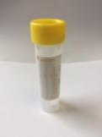
Test/Sample Type | Turn round time for results
Biofire Filmarray Meningitis Panel PCR Detection of : HSV 1+2, VZV, CMV, Enterovirus, S. pneumoniae, N. meningitidis, S. agalacticae, H. influenzae, E.coli K1, Listeria monocytogenes, Cryptococcus neoformans/gattii, Human Herpesvirus 6, Human Parechovirus | 1 working (95%)
Sampling Advice: ROYAL MARSDEN CSF SAMPLING
Specimen Requirements/ Potential interferants in the assay (drugs/ dietary compounds)
Use aseptic technique. Ideally, a minimum volume of 1mL. Leak Proof Container in sealable bag. Specimens should be transported and processed as soon as possible. If processing is delayed, refrigeration is preferable to storage at ambient temperature.
Testing for acute causes of meningitis
Processed between 08:30 and 15:30 only
Not processed out of hours
Consultant Microbiologist must be contacted for testing to be performed.
Sample Container:
YELLOW LID 30ML STERILE CONTAINER
Health and Safety Considerations
Please ensure relevant clinical
Information is provided to highlight
risks associated with this sample type
Such as:
?Meningitis, Neisseria meningitidis
Immunocpompromised
Royal College Demand Management.
Where applicable samples should not
be repeated within the stated timeframe
unless clinically indicated.
Not applicable
8707
BOLTON MICROBIOLOGY UKAS SCHEDULE WEBSITE

Slide 9
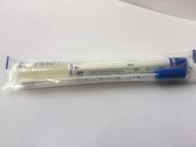
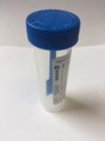
Test/Sample Type | Turn round time for results
Carbapenemase Screen • Culture • PCR | 90% within 2 working days Urgent same day; 1 working day
Sampling Advice: ROYAL MARSDEN RECTAL SWAB SAMPLING ROYAL MARSDEN FAECES SAMPLING
Sample Container:
Faeces samples blue lid container with scoop
Swab without charcoal/preservative
Specimen Requirements/ Potential interferants in the assay (drugs/ dietary compounds)
"Rectal Swabs with visible evidence of faecal matter.
Use aseptic technique.
Collect swabs into appropriate transport medium and transport in sealed plastic bags.
If processing is delayed, refrigeration is preferable to storage at ambient temperature.
Stool samples will be processed if received.
Collect specimens in appropriate leak proof containers and transport in sealed plastic bags."
Health and Safety Considerations
Please ensure relevant clinical
Information is provided to highlight
risks associated with this sample type
Such as:
?Typhoid, Foreign Travel
Royal College Demand Management.
Where applicable samples should not
be repeated within the stated timeframe
unless clinically indicated.
Trust Policy or contact ICPT
8707
BOLTON MICROBIOLOGY UKAS SCHEDULE WEBSITE

Slide 10
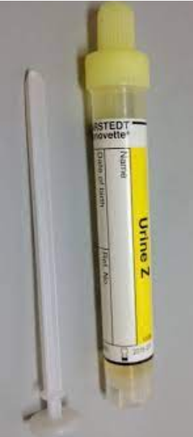
Test/Sample Type | Turn round time for results
Chlamydia PCR GC PCR | 4 working days from receipt (95% KPI) 4 working days from receipt (95% KPI)
Sampling Advice: BASHH CHLAMYDIA ADVICE BASHH GONORRHOEA ADVICE BASHH HERPES ADVICE
Sample Container:
Urine Collection Kit: yellow monovette
Hologic swab collection kit (male + female)
Specimen Requirements/ Potential interferants in the assay (drugs/ dietary compounds)
First catch urine or urethral swab for men
Vaginal swab (which may be self-collected) or endocervical swab for women are the recommended specimen types.
Collect swabs into appropriate transport medium and transport in sealed plastic bags.
Other samples are not recommended and interpretation of results should be done with care.
Health and Safety Considerations
Please ensure relevant clinical
Information is provided to highlight
risks associated with this sample type
Royal College Demand Management.
Where applicable samples should not
be repeated within the stated timeframe
unless clinically indicated.
Not applicable
NOT UKAS
ACCREDITED

Slide 11
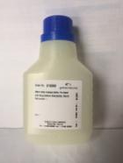
Test/Sample Type | Turn round time for results
Environmental Water Samples | 5-7 working days (96% KPI)
Sampling Advice: Joint Advisory Group on Gastrointestinal Endoscopy
Sample Container:
500ML STERILE CONTAINER
Specimen Requirements/ Potential interferants in the assay (drugs/ dietary compounds)
Water samples must be tested as soon as possible after they are collected.
If necessary they can be refrigerated for 24hrs.
Health and Safety Considerations
Please ensure relevant clinical
Information is provided to highlight
risks associated with this sample type
Such as:
LEGIONELLA OUTBREAK
Royal College Demand Management.
Where applicable samples should not
be repeated within the stated timeframe
unless clinically indicated.
Not applicable
NOT UKAS
ACCREDITED

Slide 12
Test/Sample Type | Turn round time for results
Faeces Culture | 3 working days (80%)
Sampling Advice: ROYAL MARSDEN FAECES SAMPLING
Sample Container:
Faeces samples blue lid container
with scoop
Specimen Requirements/ Potential interferants in the assay (drugs/ dietary compounds)
Use aseptic technique.
Faecal samples should be liquid or semi formed (ie take the shape of the container).
Collect specimens in appropriate leak proof containers and transport in sealed plastic bags.
Investigation of parasites Ideally three stool specimens collected over no more than a 10-day period.
It is usually recommended that specimens are collected every other day.
Please indicate if recent foreign travel.
Health and Safety Considerations
Please ensure relevant clinical
Information is provided to highlight
risks associated with this sample type
Such as: Foreign travel with region specified
Salmonella typhi, Vibrio cholerae,
Tapeworms, E.coli 0157,
Shigella dysenteriae,
Royal College Demand Management.
Where applicable samples should not
be repeated within the stated timeframe
unless clinically indicated.
7 days
8707
BOLTON MICROBIOLOGY UKAS SCHEDULE WEBSITE

Slide 13
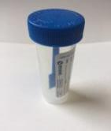
Test/Sample Type | Turn round time for results
FAECES GDH (EIA)- Presence of C. dfficile bacteria CDT (EIA)- Presence of Toxin produced by C.difficile TOXIN GENE DETECTION (PCR) (Not currently included in UKAS Schedule) – Presence of Gene where C.difficile has been detected but no toxin has been detected. | Same day for urgent requests 1 day for routine (95% KPI)
Sampling Advice: ROYAL MARSDEN FAECES SAMPLING
Sample Container:
Faeces samples blue lid container
with scoop
Specimen Requirements/ Potential interferants in the assay (drugs/ dietary compounds)
Fresh Sample
Samples may be cultured up to 48hrs after collection although interpretation of results should be done with care.
Leak Proof Container in sealable bag.
Health and Safety Considerations
Please ensure relevant clinical
Information is provided to highlight
risks associated with this sample type
Such as:Foreign travel with region specified
Salmonella typhi, Vibrio cholerae,
Tapeworms, E.coli 0157,
Shigella dysenteriae,
Royal College Demand Management.
Where applicable samples should not
be repeated within the stated timeframe
unless clinically indicated.
CDTOX POS 28 days
GDH POS 7 days
8707
BOLTON MICROBIOLOGY UKAS SCHEDULE WEBSITE

Slide 14
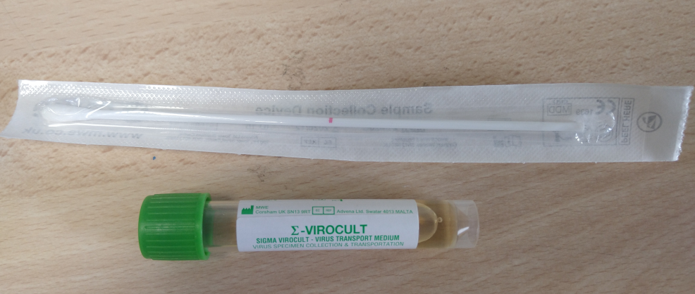
Test/Sample Type | Turn round time for results
COVID only PCR COVID FLU A/B, RSV combined PCR | Urgent requests same day (95% KPI)
Sampling Advice: ROYAL MARSDEN NOSE SAMPLING
Specimen Requirements/ Potential interferants in the assay (drugs/ dietary compounds)
Please contact the lab ext 5412 in working hours or on bleep 3020 to notify us of urgent samples
Leak Proof Container in sealable bag. Do not place other samples in the same bag
Please specify if patient has symptoms requiring FLU/RSV testing or if COVID testing only is required
Sample Container:
VIRAL TRANSPORT MEDIA
NOT UKAS
ACCREDITED
Health and Safety Considerations
Please ensure relevant clinical
Information is provided to highlight
risks associated with this sample type
Such as:
TB Contact, Previous TB, ?SARS, ?MERS
TRAVEL HISTORY, ?LEGIONELLA

Slide 15
Test/Sample Type | Turn round time for results
Routine Genital Culture | 2-3 working days (95% KPI)
Sampling Advice: ROYAL MARSDEN VAGINAL SAMPLING
Specimen Requirements/ Potential interferants in the assay (drugs/ dietary compounds)
"Samples of pus/exudate, if present, are preferred to swabs.
Use aseptic technique.
Collect swabs into appropriate transport medium and transport in sealed plastic bags.
If processing is delayed, refrigeration is preferable to storage at ambient temperature."
Sample Container:
BLUE LID SWAB WITH PRESERVATIVE
Health and Safety Considerations
Please ensure relevant clinical
Information is provided to highlight
risks associated with this sample type
Such as: STI’S, KNOWN HIV
Royal College Demand Management.
Where applicable samples should not
be repeated within the stated timeframe
unless clinically indicated.
Not applicable
8707
BOLTON MICROBIOLOGY UKAS SCHEDULE WEBSITE

Slide 16
Test/Sample Type | Turn round time for results
Routine GUM Culture | 3-4 working days (90% KPI)
Sampling Advice: ROYAL MARSDEN VAGINAL SAMPLING ROYAL MARSDEN RECTAL SWAB SAMPLING
ROYAL MARSDEN THROAT SAMPLING
Sample Container:
BLUE LID SWAB WITH PRESERVATIVE
Specimen Requirements/ Potential interferants in the assay (drugs/ dietary compounds)
"Samples of pus/exudate, if present, are preferred to swabs.
Use aseptic technique.
Collect swabs into appropriate transport medium and transport in sealed plastic bags.
If processing is delayed, refrigeration is preferable to storage at ambient temperature."
Health and Safety Considerations
Please ensure relevant clinical
Information is provided to highlight
risks associated with this sample type
Such as: STI’S, KNOWN HIV,
N. meningitidis carriage
Royal College Demand Management.
Where applicable samples should not
be repeated within the stated timeframe
unless clinically indicated.
Not applicable
8707
BOLTON MICROBIOLOGY UKAS SCHEDULE WEBSITE

Slide 17
Test/Sample Type | Turn round time for results
Helicobacter pylori | 1-2 working days (90% KPI)
Sampling Advice: ROYAL MARSDEN FAECES SAMPLING
Specimen Requirements/ Potential interferants in the assay (drugs/ dietary compounds)
Use aseptic technique.
Collect specimens in appropriate leak proof containers and transport in sealed plastic bags.
If transport is not immediate samples can be stored at 2-8C for 1 week.
Sample Container:
Faeces samples blue lid container
with scoop
Health and Safety Considerations
Please ensure relevant clinical
Information is provided to highlight
risks associated with this sample type
Such as:Foreign travel with region specified
Salmonella typhi, Vibrio cholerae,
Tapeworms, E.coli 0157,
Shigella dysenteriae,
Royal College Demand Management.
Where applicable samples should not
be repeated within the stated timeframe
unless clinically indicated.
28 days
8707
BOLTON MICROBIOLOGY UKAS SCHEDULE WEBSITE

Slide 18
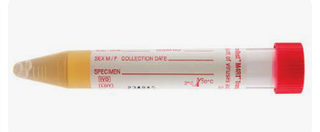
Test/Sample Type | Turn round time for results
HSV PCR Genital Samples | 6 working days (90% KPI)
Sampling Advice: BASHH HERPES ADVICE
Specimen Requirements/ Potential interferants in the assay (drugs/ dietary compounds)
Collect swabs into appropriate transport medium and transport in sealed plastic bags.
Sample type: Male and female, swab in viral transport media
Health and Safety Considerations
Please ensure relevant clinical
Information is provided to highlight
risks associated with this sample type
Royal College Demand Management.
Where applicable samples should not
be repeated within the stated timeframe
unless clinically indicated.
Not applicable
8707
BOLTON MICROBIOLOGY UKAS SCHEDULE WEBSITE

Slide 19
Test/Sample Type | Turn round time for results
MRSA Screens Negative screens Positive screens | 98% of all samples processed within 2 days of receipt
Sampling Advice: ROYAL MARSDEN NOSE SAMPLING
Specimen Requirements/ Potential interferants in the assay (drugs/ dietary compounds)
Use aseptic technique.
Please include all clinically infected sites as part of an MRSA screen.
Collect swabs into appropriate transport medium and transport in sealed plastic bags. I
f processing is delayed, refrigeration is preferable to storage at ambient temperature.
Sample Container:
BLUE LID SWAB WITH PRESERVATIVE
Health and Safety Considerations
Please ensure relevant clinical
Information is provided to highlight
risks associated with this sample type
Royal College Demand Management.
Where applicable samples should not
be repeated within the stated timeframe
unless clinically indicated.
7 days
Unless Clinically Indicated/Trust Policy
8707
BOLTON MICROBIOLOGY UKAS SCHEDULE WEBSITE

Slide 20
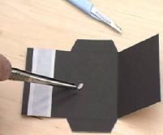
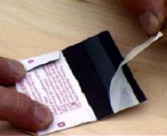
Test/Sample Type | Turn round time for results
Mycology Samples FILM CULTURE | 5-7 working days (90% KPI) 3-4 weeks (92% KPI)
Sampling Advice: PHE FUNGAL DERMATOLOGY SAMPLING
Specimen Requirements/ Potential interferants in the assay (drugs/ dietary compounds)
Specimens should be kept at room temperature and transported and processed as soon as possible although, provided the samples are kept dry, the fungus will remain viable for several months.
Sample Container:
DERMAPAK BLACK
Health and Safety Considerations
Please ensure relevant clinical Information is provided to highlight risks associated with this sample type:
Coccidioides, Histoplasma, Penicillium marneffei,
CONTACT WITH BIRDS/BATS, Erythema nodosum
Royal College Demand Management.
Where applicable samples should not
be repeated within the stated timeframe
unless clinically indicated.
3 months
8707
BOLTON MICROBIOLOGY UKAS SCHEDULE WEBSITE

Slide 21
Test/Sample Type | Turn round time for results
Norovirus EIA | Urgent requests same day before 4pm; 1 working day for routine 1-2 Working days (95% KPI)
Sampling Advice: ROYAL MARSDEN FAECES SAMPLING
Specimen Requirements/ Potential interferants in the assay (drugs/ dietary compounds)
Use aseptic technique. Collect specimens in appropriate leak proof containers and transport in sealed plastic bags. Collect swabs into appropriate transport medium and transport in sealed plastic bags.
Sample Container:
Faeces samples blue lid container
with scoop
Health and Safety Considerations
Please ensure relevant clinical
Information is provided to highlight
risks associated with this sample type
Such as:Foreign travel with region specified
Salmonella typhi, Vibrio cholerae,
Tapeworms, E.coli 0157,
Shigella dysenteriae,
Royal College Demand Management.
Where applicable samples should not
be repeated within the stated timeframe
unless clinically indicated.
N/A
8707
BOLTON MICROBIOLOGY UKAS SCHEDULE WEBSITE

Slide 22
Test/Sample Type | Turn round time for results
FAECES Rota/Adenovirus | 2-3 working days (90% KPI)
Sampling Advice: ROYAL MARSDEN FAECES SAMPLING
Specimen Requirements/ Potential interferants in the assay (drugs/ dietary compounds)
Use aseptic technique.
Collect specimens in appropriate leak proof containers and transport in sealed plastic bags.
Collect swabs into appropriate transport medium and transport in sealed plastic bags.
If transport is not immediate samples can be stored at 2-8C for 1 week.
Sample Container:
Faeces samples blue lid container
with scoop
Health and Safety Considerations
Please ensure relevant clinical
Information is provided to highlight
risks associated with this sample type
Such as:Foreign travel with region specified
Salmonella typhi, Vibrio cholerae,
Tapeworms, E.coli 0157,
Shigella dysenteriae,
Royal College Demand Management.
Where applicable samples should not
be repeated within the stated timeframe
unless clinically indicated.
N/A
8707
BOLTON MICROBIOLOGY UKAS SCHEDULE WEBSITE

Slide 23
Test/Sample Type | Turn round time for results
Routine Sputum Culture | 2-3 working days (90% KPI)
Sampling Advice: ROYAL MARSDEN SPUTUM SAMPLING
Sample Container:
YELLOW LID 60ML STERILE CONTAINER
Specimen Requirements/ Potential interferants in the assay (drugs/ dietary compounds)
Fresh Sample
Samples may be cultured up to 48hrs after collection although interpretation of results should be done with care.
Leak Proof Container in sealable bag.
Health and Safety Considerations
Please ensure relevant clinical
Information is provided to highlight
risks associated with this sample type
Such as:
TB Contact, Previous TB, ?SARS, ?MERS
TRAVEL HISTORY, ?LEGIONELLA
Royal College Demand Management.
Where applicable samples should not
be repeated within the stated timeframe
unless clinically indicated.
Not applicable
8707
BOLTON MICROBIOLOGY UKAS SCHEDULE WEBSITE

Slide 24
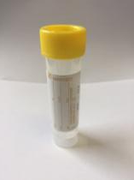
Test/Sample Type | Turn round time for results
Sterile Fluid Investigation Microscopy Culture | Urgent requests same day; 1 working day for routine 2-3 working days (95% KPI)
Sampling Advice: PHE STERILE FLUID SAMPLING
ROYAL MARSDEN CSF SAMPLING
Specimen Requirements/ Potential interferants in the assay (drugs/ dietary compounds)
Use aseptic technique.
Ideally, a minimum volume of 1mL.
Leak Proof Container in sealable bag.
Specimens should be transported and processed as soon as possible.
If processing is delayed, refrigeration is preferable to storage at ambient temperature.
For CSF please state if further examinations are required such as Viral PCR.
Sample Container:
YELLOW LID 30ML STERILE CONTAINER
Health and Safety Considerations
Please ensure relevant clinical
Information is provided to highlight
risks associated with this sample type
Such as:
REFER TO CLINICAL INFORMATION
Royal College Demand Management.
Where applicable samples should not
be repeated within the stated timeframe
unless clinically indicated.
N/A
8707
BOLTON MICROBIOLOGY UKAS SCHEDULE WEBSITE

Slide 25
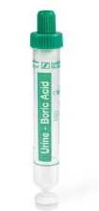
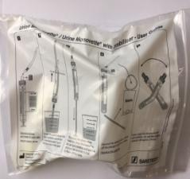
Test/Sample Type | Turn round time for results
Urine Microscopy (not UKAS accredited) Culture and Sensitivities | 1 working days (95% KPI) 2 working days (90% KPI)
Sampling Advice: ROYAL MARSDEN URINE SAMPLING
Sample Container:
GREEN URINE CONTAINER
Specimen Requirements/ Potential interferants in the assay (drugs/ dietary compounds)
Rapid transport, culture, or measures to preserve the sample aid reliable laboratory diagnosis.
Delays and storage at room temperature allow organisms to multiply, which generates results that do not reflect the true clinical situation.
Where delays in processing are unavoidable, refrigeration at 4°C is recommended.
For GP samples. Please follow the instructions on the bag provided.
Health and Safety Considerations
Please ensure relevant clinical
Information is provided to highlight
risks associated with this sample type
Royal College Demand Management.
Where applicable samples should not
be repeated within the stated timeframe
unless clinically indicated.
3 DAYS
8707
BOLTON MICROBIOLOGY UKAS SCHEDULE WEBSITE

Slide 26
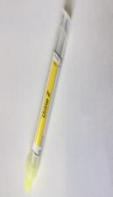
Test/Sample Type | Turn round time for results
Urinary Antigen Testing Legionella S.pneumoniae | Urgent requests same day; 1 working day for routine (95% KPI)
Sampling Advice: ROYAL MARSDEN URINE SAMPLING
Sample Container:
YELLOW URINE Z CONTAINER
Specimen Requirements/ Potential interferants in the assay (drugs/ dietary compounds)
Urine samples must be tested as soon as possible after they are collected.
If necessary they can be refrigerated for 1 week.
Urine samples can be tested within 24hrs when stored at room temperature.
If necessary samples can be refrigerated for 2 weeks.
Health and Safety Considerations
Please ensure relevant clinical
Information is provided to highlight
risks associated with this sample type
Royal College Demand Management.
Where applicable samples should not
be repeated within the stated timeframe
unless clinically indicated.
7 DAYS
8707
BOLTON MICROBIOLOGY UKAS SCHEDULE WEBSITE

Slide 27
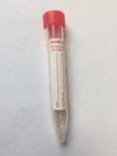
Test/Sample Type | Turn round time for results
VIRAL TRANSPORT MEDIA for Testing of Respiratory Viruses or other Viruses requiring Molecular Testing (See MMU UserGuide) | Refer to Referral Laboratory User Guides
Sampling Advice: ROYAL MARSDEN NOSE SAMPLING
Sample Container:
VIRAL TRANSPORT MEDIA
Specimen Requirements/ Potential interferants in the assay (drugs/ dietary compounds)
Red Top Viral Transport Media
Media can be obtained from Laboratory Medicine Reception during the day.
Out of Hours samples can be obtained from the room on the left as you enter the Laboratory Medicine reception corridor
Staff who can collect Blood for Transfusion are able to enter this room out of hours
Health and Safety Considerations
Please ensure relevant clinical
Information is provided to highlight
risks associated with this sample type
Such as:
TB Contact, Previous TB, ?SARS, ?MERS
TRAVEL HISTORY, ?LEGIONELLA
Royal College Demand Management.
Where applicable samples should not
be repeated within the stated timeframe
unless clinically indicated.
N/A

Slide 28
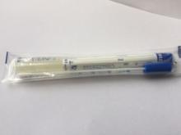
Test/Sample Type | Turn round time for results
Wound Swabs EYE, EAR, THROAT Consultant Special Interest (tissue, NBL, PUS) Deep Wounds | 3-4 working days (95% KPI, Complicated samples with multiple ID and Sensitivities) 4-5 working days (95% KPI, Complicated samples with multiple ID, Sensitivities and broth culture) 2-3 working days (90% KPI) Complicated samples with multiple ID and sens.
Sampling Advice: ROYAL MARSDEN SWAB SAMPLING
PHE PUS AND EXUDATES PHE TISSUE AND BIOPSY
PHE LAVAGE, NBL
Specimen Requirements/ Potential interferants in the assay (drugs/ dietary compounds)
Samples of pus/exudate, if present, are preferred to swabs. Use aseptic technique.
Collect swabs into appropriate transport medium and transport in sealed plastic bags.
If processing is delayed, refrigeration is preferable to storage at ambient temperature.
Collect specimens before antimicrobial therapy where possible.
Please provide relevant clinical information including travel history for Brain Abscess
Sample Container:
YELLOW LID 60ML
STERILE CONTAINER FOR
FLUIDS AND TISSUE
Sample Container:
BLUE LID SWAB WITH
PRESERVATIVE
Health and Safety Considerations
Please ensure relevant clinical
Information is provided to highlight
risks associated with this sample type
Such as:
REFER TO CLINICAL INFORMATION
Royal College Demand Management.
Where applicable samples should not
be repeated within the stated timeframe
unless clinically indicated.
7 DAYS FOR ROUTINE SWABS
8707
BOLTON MICROBIOLOGY UKAS SCHEDULE WEBSITE

Slide 29
Test/Sample Type | Turn round time for results
VRE SCREEN | 1-2 working days (90% KPI)
Sampling Advice: ROYAL MARSDEN RECTAL SWAB SAMPLING ROYAL MARSDEN FAECES SAMPLING
Sample Container:
Faeces samples blue lid container with scoop
Swab without charcoal/preservative
Specimen Requirements/ Potential interferants in the assay (drugs/ dietary compounds)
"Rectal Swabs with visible evidence of faecal matter.
Use aseptic technique.
Collect swabs into appropriate transport medium and transport in sealed plastic bags.
If processing is delayed, refrigeration is preferable to storage at ambient temperature.
Stool samples will be processed if received.
Collect specimens in appropriate leak proof containers and transport in sealed plastic bags."
Health and Safety Considerations
Please ensure relevant clinical
Information is provided to highlight
risks associated with this sample type
Such as:
?Typhoid, Foreign Travel
Royal College Demand Management.
Where applicable samples should not
be repeated within the stated timeframe
unless clinically indicated.
Trust Policy
8707
BOLTON MICROBIOLOGY UKAS SCHEDULE WEBSITE

