Slide 1


Annual Members’
Meeting
16 October 2023

Slide 2
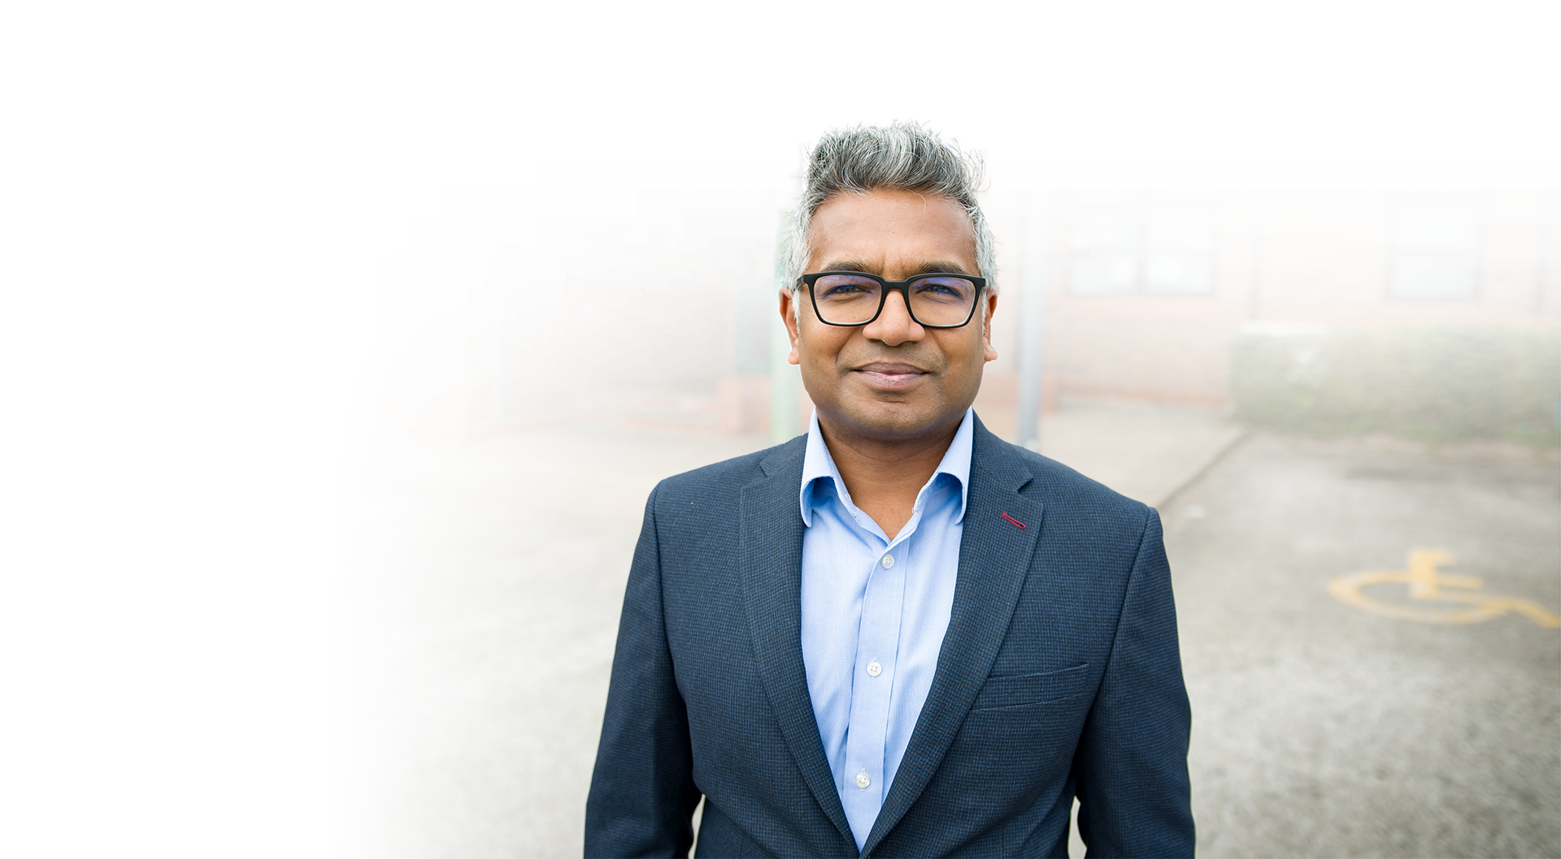

Dr Niruban Ratnarajah
Chair

Slide 3



Slide 4


Closing
statement
Review of the year
Fiona Noden
Chief Executive and
Place Based Lead

Slide 5

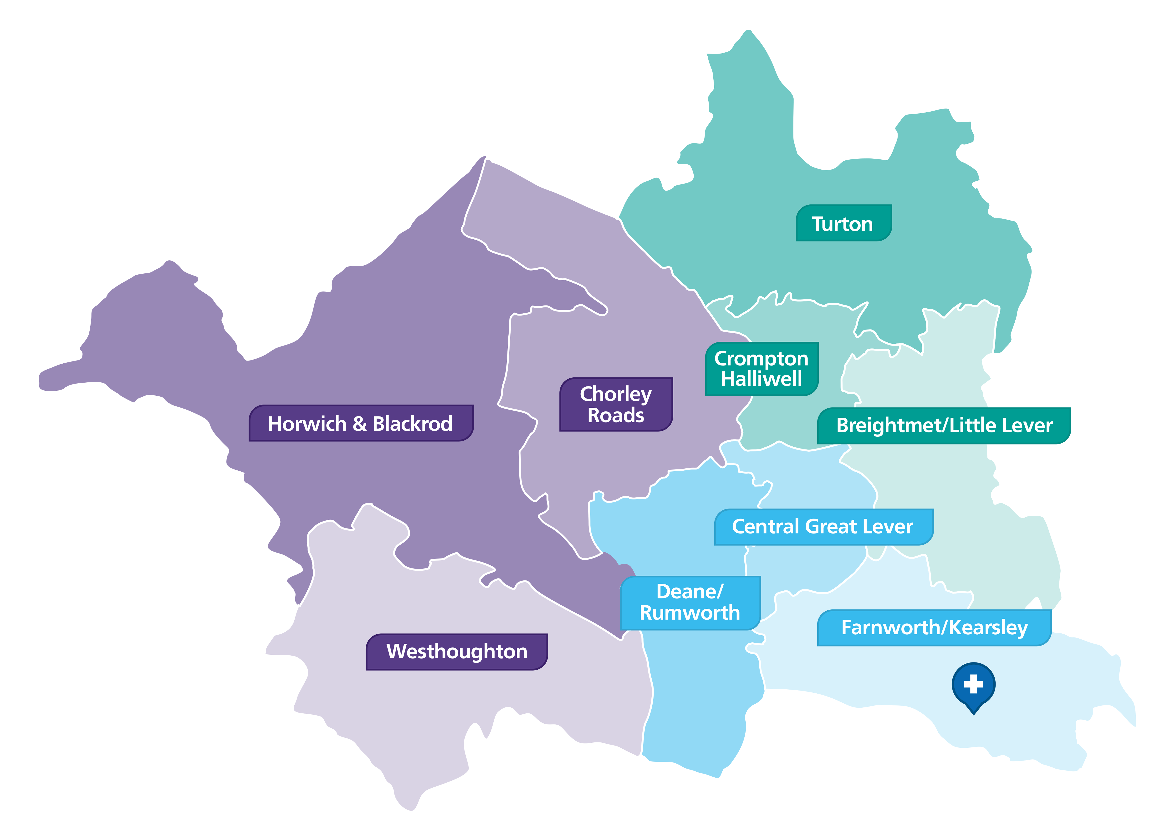
About Bolton
3 districts moving to 6 neighbourhoods
3 district health and care teams mobilised during Covid-19
Neighbourhood boundaries
(strategic delivery footprint)
6 health and care neighbourhoods with integrated teams aligned to PCNs & connected to place
9 Primary Care Networks
1 Hospital site
22 Community settings
2 Community Intermediate Care Units
3 Community Nursing Districts
Aligned dedicated voluntary, community, faith and social
enterprise (VCFSE) leads

Slide 6






Our Strategy 2019-2024
Our Purpose: We want to deliver better healthcare services for Bolton.
Our care will be of the quality we would want for ourselves, our families and our friends.
Our Vision
Our Values
Our Ambitions
Our Outcomes
Our Future
What is our priority?
What is important to us?
What will we do?
What will we achieve?
What will we look like?
Vision
Openness
Integrity
Compassion
Excellence
To be recognised as an excellent provider of health and care and a great place to work
To provide safe, high quality and compassionate care to every person every time
Rated Outstanding by the CQC
We want to be...
An Integrated Care Organisation, where care is joined up and provided in the most appropriate location and which is the provider of choice for community health and care services
A provider of a range of safe local and specialist hospital services to the people of Bolton and beyond
A centre of excellence for women’s and children’s health
A digital pioneer and centre for digital excellence
To be a great place to work, where all staff feel valued and can reach their full potential
Top 20% Staff Survey
Financially sustainable
To continue to use resources wisely so that we can invest in and improve our services
Estate masterplan is agreed and published
Our estate will be sustainable and developed in a way that supports staff and community Health and Wellbeing
Health and wellbeing framework is in place
To integrate care to prevent ill health, improve
wellbeing and meet the needs of the people of Bolton
Develop an on-site campus for the training of our current and future workforce
To develop partnerships that will improve services and support education, research and innovation

Slide 7
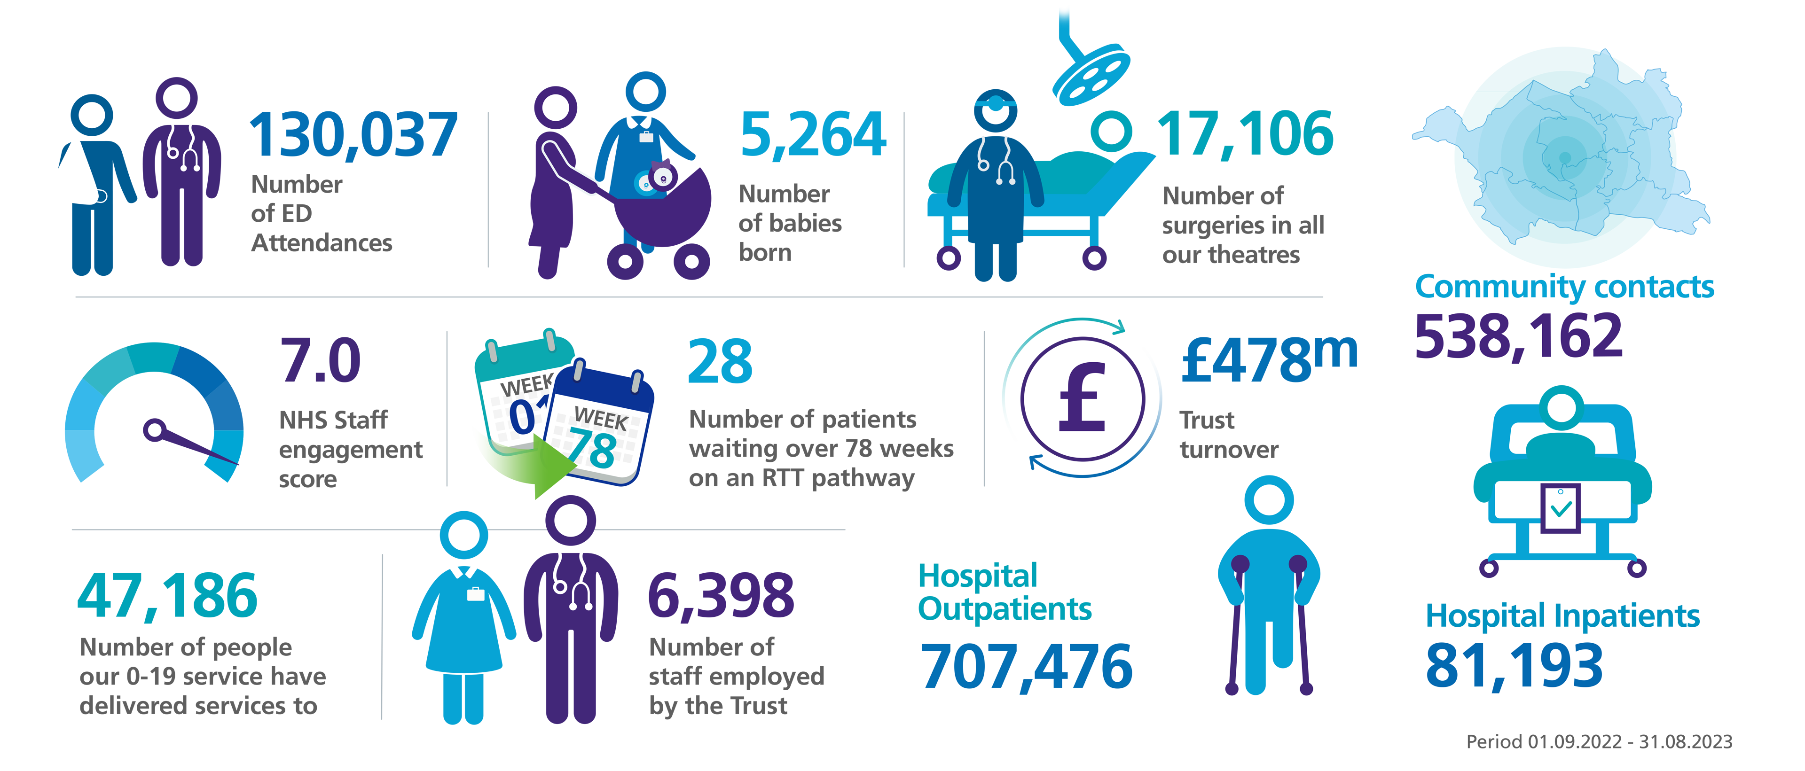
Our year in numbers

Slide 8
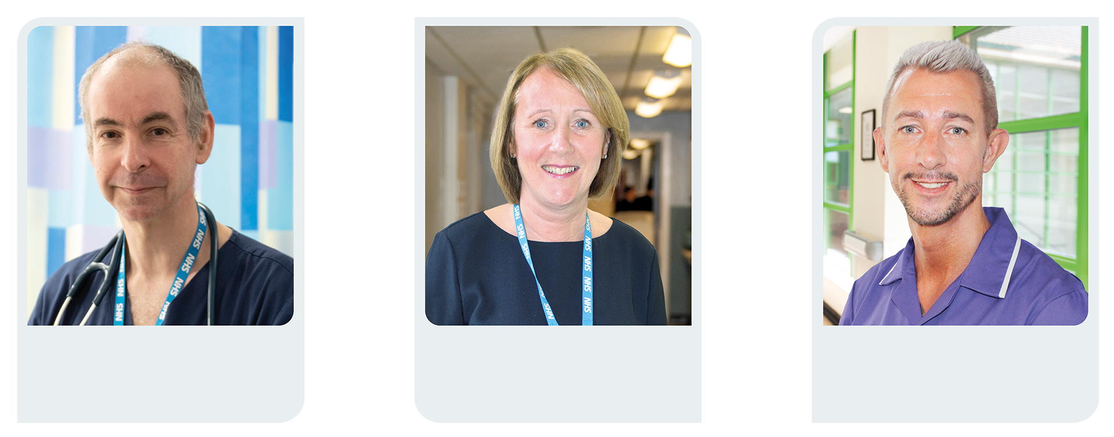
Francis Andrews
Medical Director
Rae Wheatcroft
Chief Operating Officer
Tyrone Roberts
Chief Nursing Officer

Slide 9

  A look back at 2022/23 – Francis
Continued focus on reducing deaths in hospital
  Our Trust mortality rate is within the ‘as expected range’
  Learning from any themes via learning from deaths committee and mortality reduction group
  Training to improve our response to deteriorating patients
Continued focus on reducing harm in hospital
  Training in place for foundation doctors
  Improved documentation using electronic patient records
  Significant reduction in patient hypoglycemic (low blood sugar) episodes
  Improved response times for unplanned critical care admissions
Notes:
Reducing deaths in hospital:
We have seen a reduction in our SHMI to return to within normal limits and we have a learning from deaths process that focuses on themes rather than individual cases for learning this is massive and defo needs calling out ☺
Role of of RR-SAFER training to improve response to deteriorating patients
Reducing harm in hospital:
We have new formal training in place for foundation doctors on deteriorating patients.
Role of Sepsis screening documentation on EPR
ICD Quality account significant reduction in hypoglycaemic episodes
We have a new CQUIN for 2022-2023 to improve Recording of NEWS2 score, escalation time and response time for unplanned critical care admissions in ASSD which is showing 86% compliance (national target 60%)

Slide 10
  A look back at 2022/23 – Rae
We treated the vast majority of our patients who had been waiting for 18 months
We recovered our cancer treatment backlog to pre-pandemic levels
Our builds for new theatres and Community Diagnostic Centre have progressed at pace
We refined our Urgent Treatment Centre model, building on the pilot
We expanded our Same Day Emergency Care service pathways
We developed and expanded our urgent community response service
We improved our ambulance handover performance
We've been part of a GM wide programme to upgrade our Laboratory Information Management System
Notes:
Rae

Slide 11
  A look back at 2022/23 – Tyrone
Improved our response to serious incidents with 75+% investigations with the family/patient <60 working days
Enhanced the accreditation process (BoSCA) and improved in 17/19 standards
Welcomed 181 international nurses & on track to increase nurse associates from 54
to 159 by April 2023
Developed a more person-centred bedside handover process
Launched a new internal leadership programme alongside a talent management process for all nurses, midwives, Allied Health Practitioners & Healthcare Scientists
Developed a draft Quality Improvement strategy
Delivered statistical reduction in hospital and community category 3 pressure ulcers

Slide 12
  Looking forward to 2023/24 – Francis
Reducing deaths in hospital
  Learning from implementation of community medical examiner system
  Greater use of Advanced Care Planning and Electronic Palliative Care Co-ordination System
Reducing harm in hospital:
  Pilot to capture patient, carer and relative concerns around deterioration
  Adoption of 2023 NICE sepsis guidance (once released)
  Improved pathway for patients with diabetic feet complications
Embedding Quality Improvement to improve care
Notes:
Francis

Slide 13
  Looking forward to 2023/24 – Rae
We will have no patients waiting longer than 65 weeks for their planned care
We will have implemented new cancer standards and recovered performance
We are aiming to recover 4 hour Emergency Department access standard to 76%
We are aiming to recover our 6 week diagnostic access standard to 95%
We will open our new theatres and our Community Diagnostic Centre
Implementing a sustainable model for our Urgent Treatment Centre
Complete our Laboratory Information Management System upgrade
Using Robotic Process Automation to make our services more efficient and effective
Notes:
Rae

Slide 14
  Looking forward to 2023/24 – Tyrone
Notes:
Tyrone – 1) 95% complaint response times and delivery of CQC improvement plans, 2) finalise QI strategy 3) working with workforce colleagues, re profile workforce plan alongside NHS plan for next 3 years 4) receive and act upon enhanced experience feedback 5) launch on 'person centred' coordination group 6) understand and then agree forum to increase voice of AHPs and HCS

Slide 15
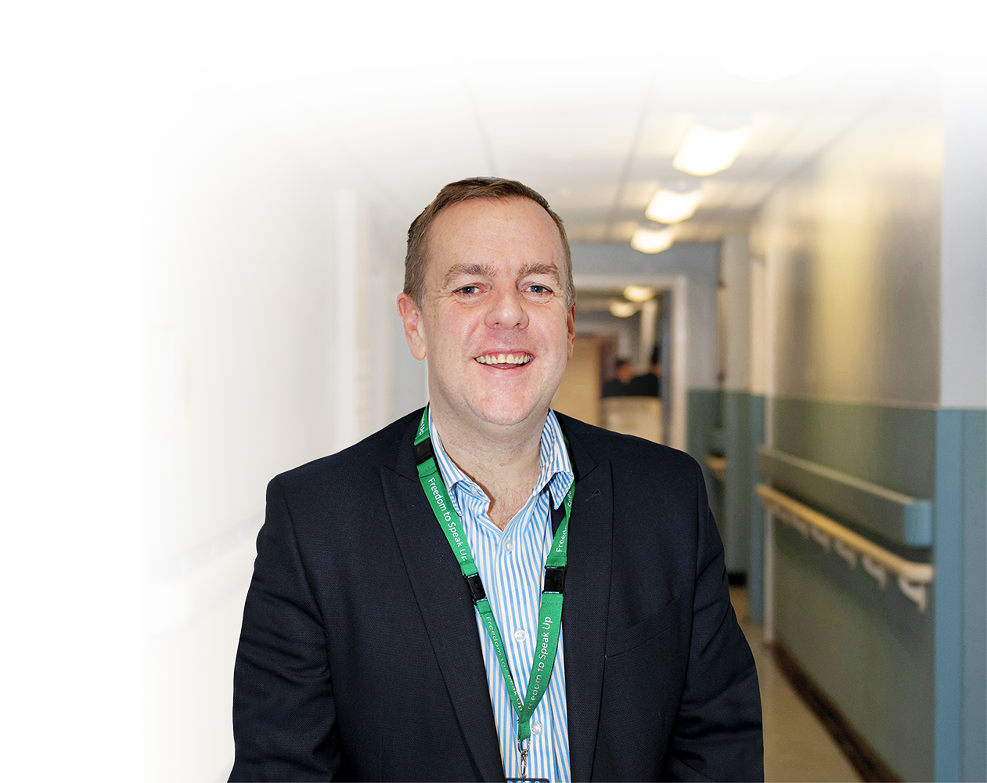

James Mawrey
Director of People

Slide 16

  A look back at 2022/23
People Strategy agreed by Board of Directors, setting out the direction of travel for supporting our people
Recruitment – progress made but more work to do in hard to fill areas
NHS Staff Survey - remain the best in GM and top 20% but response rate fallen
FTSU – more concerns raised year on year and focusing on concerns about confidentiality
Focus on health and wellbeing initiatives linked to sickness rate positive compared to GM
Inclusion – WRES and WDES findings positive in areas but of course more to do
New staff networks have been set up and three existing becoming better embedded
Employee Relations – huge amount of work to ensure all our staff exhibit our VOICE values
Bespoke OD programmes in place across the organisation where we know problem areas, for example Maternity
Recognition programme well established - Monthly recognition schemes, Annual Staff Awards, Long Service
Introduced the People & Culture Locality Group
Achieved our target for Apprenticeships and Mandatory Training

Slide 17
  Looking forward to 2023/24
  Our Voice Change Programme
  FTSU – utilising external support where staff are concerned about raising with our Guardians
  OD Cultural Dashboard – bringing together the plethora of information
  Recruitment – focus on hard to fill and clinically essential positions
  Experience, Wellbeing and Retention - best place to work, flexibilities managing work/life
  NHSP introduction
  Drive down reliance on Agency and Variable pay spend and realign to more substantive workforce
  Further work to ensure that our workforce is representative of our local population
  Continuing to transform our workforce across Bolton – working with our partners
  New Leadership Development Programme

Slide 18
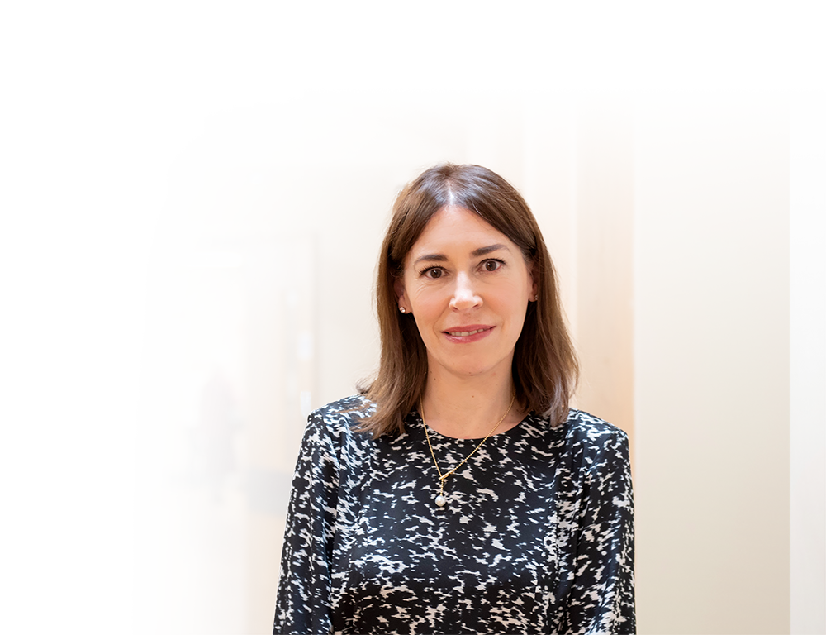
Annette Walker
Chief Finance Officer

Slide 19

  A look back at 2022/23
Revenue performance deficit of £1.5m
Reported position - surplus of £2.4m (after impairments and technical adjs)
Cash held in bank £58.2m
Capital spend of £42.1m
Better payment practices code – performance of 91.3% v target of 95%
Accounts audited and submitted

Slide 20
  Looking forward to 2023/24
Revenue performance – performance deficit plan of £12.4m
Likely forecast outturn performance deficit of £12.4m
Year end cash forecast of £1.7m
Capital plan £19.5m which includes completing the new theatres
and community diagnostic hubs
IFRS 16 lease plan £12.3m
Managing financial pressures – inflation, energy and pay
Very challenging cost improvement requirements of £19.3m

Slide 21

  A look back at 2022/23
  Re-structure of the Estates and Facilities Team and development of iFM governance model
  Management of key Capital projects excess of £30m
  Completion of a 6 Facet Survey building overlay, highlighting the high and significant Estates risks, enabling creation of a Capital Investment Plan
  Development of the iFM Computer Aided Facilities Management system
  Implementation of the Green Plan action plans to meet the 2040 NHS net-zero targets
  Catering Team won NHSE Catering of the Year Award
  1,500 pieces of new medical equipment procured and commissioned
Notes:
Capital Investment Plan prioritises short, medium and long term investment required to reduce the £79m “backlog” maintenance
CAFM system provides Quality Assurance for compliance and KPIs

Slide 22
  Looking forward to 2023/24
  Developing a revised Bolton FT master plan, to aligning to the Clinical Strategy
  Creation of a new Estates Strategy
  Four new modular theatres will be commissioned in Q3 2023, ready for opening by December 2023
  New Community Diagnostic Centre to be commissioned Q1 2024, opening by end of March 2024
  Design and build of the new paediatric hub – to be opened by March 2024
  September 2024 opening of the Institute of Medical Science
  Review of the Strategic Estates requirements, including scaling of leases and agile working opportunities
  Implementation of a 24 hour patient catering services
  Development of iFM People Plan
Notes:
Master plan also creates plan for potential reduction of the overall footprint of the Trust and has full site utilization review
Overall iFM ambition is that together we will continue to develop an Estate that is not only safe and fit for the future, but is one we are proud of, for all our patients, staff and the wider Bolton community

Slide 23
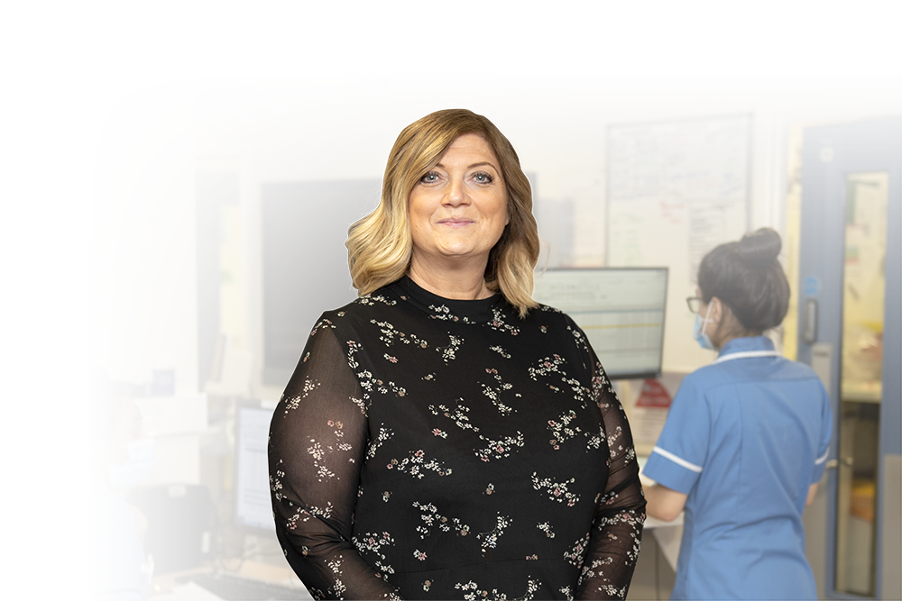
Sharon White
Director of Strategy,
Digital and Transformation

Slide 24

Ambitions 5 and 6
To integrate care and develop partnerships
  A look back at 2022/23
CEO took up role as Place-Based Lead for Bolton Locality
Shared governance structure under our Locality Board to help us improve health and wellbeing in Bolton
Began a programme of workforce transformation to help our staff to deliver a
strengths-based approach to care
Neighbourhood teams reconfigured linked to the GPs Primary Care Networks
Shared Budget for Bolton
Worked closely with our NHS partners across Greater Manchester to support our collective recovery
Health Informatics and Innovation Partnerships with the college and university
FT increased our digital capabilities and infrastructure with investments in WiFi
Established Strategy & Operations Committee

Slide 25
Ambitions 5 and 6
To integrate care and develop partnerships
  Looking forward to 2023/24
Finalise Bolton’s Locality Strategy
Publishing our refreshed Trust and Clinical Strategies
Community Engagement and Empowerment – Voice of the Public
Working on system solutions to long-standing issues i.e. discharge and flow between providers
Bolton wide workforce plan to develop their skills in a way that support our population to live well for longer
Health Inequalities Framework
New Faith Facilities funded charity and communities
Bolton wide digital partnership
Full implementation of neighbourhood model
Active partner in the GM Trust Provider Collaborative
Delivery of GM and FT Digital Strategy and final stages of EPR
Notes:
Gaining the Voice of the Public The Locality Board approved a locality approach to communications and engagement, which will engage all partners to work as a local engagement system, avoiding duplication and fully interacting across the locality. Full commitment to the proposals had been given by all partners to develop a model and framework to ensure people’s views across the community are heard and reflected within our plans and priorities, allowing for real influence in decision making, reaching all neighbourhoods

Slide 26

Any questions?

Slide 27
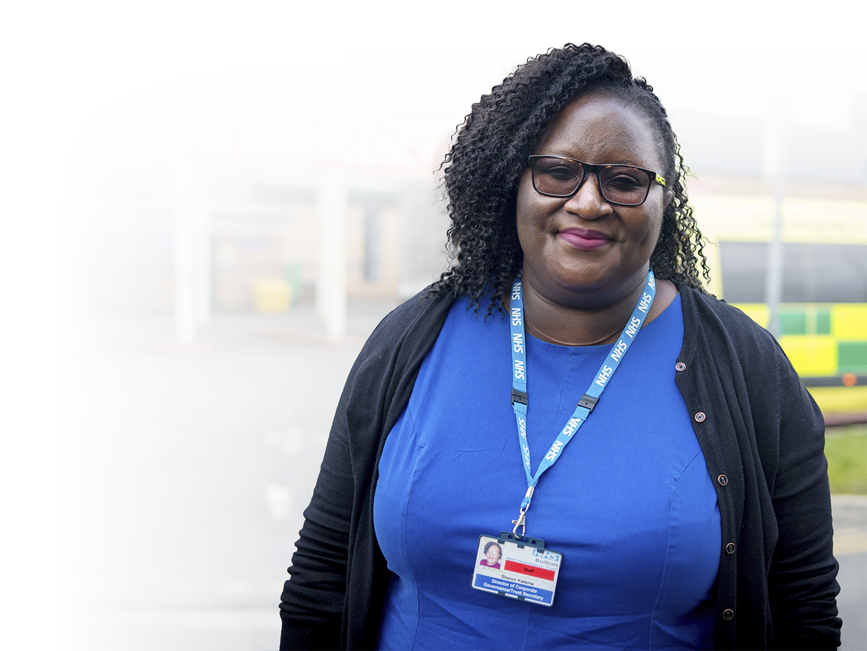
Sharon Katema
Director of Corporate Governance
and Trust Secretary

Slide 28
Election Results 2023
  Elections held by single transferable vote for seven
  public governor and three staff governor positions.
  Thank you to the following Governors who completed their term of office in 2023:
Area | Elected
Bolton North East | Edward Gorman Dalton Thompson
Bolton South East | Paul Best
Bolton West | Malcolm Bristow David Thomas Elaine Catterall Grace Hopps
Nurses and Midwives | Jean Cummings
AHP and Scientists | Cara Burns
Janice Drake
Janet Whitehouse
Tracey Holliday
Martin Anderson
Leigh Vallance
Dawn Hennefer
Jane Howarth
Newly Appointed Governors: Dave Bagley, Bolton CVS Dawn Yates, Bolton CVS Melanie Rushton, Salford University Adele Nightingale, University of Bolton

Slide 29
Membership Update
We have re-launched the Membership Matters Newsletter
We will be contacting members to discuss how we communicate
We are working with Bolton Youth Transformation Board to appoint a Youth Governor
Looking to engage more with our members over the next year
 | Public Constituency | Staff Constituency
At year start 1 April 2022 | 4,949 | 6,367
At year end 31 March 2023 | 4,870 | 6,671

Slide 30
Closing
statement
Fiona Noden
Chief Executive and
Place Based Lead

